Slide 1
BUILDING
A NEW INDUSTRY
NATIONAL CAMPAIGN FOR FINANCIAL LITERACY

Slide 2
UNCERTAINTY ON THE HORIZON
The world is changing in unpredictable ways,
and so is our financial future.
To cut costs, many companies are moving jobs overseas.
Many small businesses may have limited capital, making it more difficult to compete against big chains with large distribution systems.
Automation may mean more job losses.
Traditionally, we work for 40 years, between the ages of 25 to 65,
and then retire. But now, younger people may have difficulty finding gainful employment and may struggle throughout their retirement years.

Slide 3
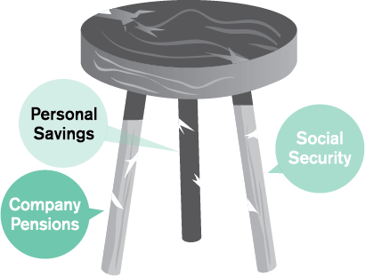
OBSTACLES AHEAD
Retirement Crisis
You should pay attention to the traditional
pillars of retirement
Poor saving habits.
Fewer companies offer pensions.
Retirement benefits such as Social Security.
Education Crisis
Tuition costs keep rising.
Student loans can be a major burden.
Some graduates are having trouble finding good jobs and the right career for them.
Spending Crisis
Budget deficits and rising national debt could increase pressure on our government to raise taxes and reduce funding to retirement programs, like Social Security.
Some people spend more on things they don’t need with money they don’t have.
Keeping up with our social media friends can get very expensive.

Slide 4
WHAT IS YOUR SITUATION RIGHT NOW?
Do you have problems paying your bills?
Are your children growing up and your parents growing old faster than you can provide for them?
Are you concerned about your job? Your career?
Are you paid what you are worth?
Do you feel financially trapped? Is it affecting your family?
It’s ironic that we live in one of the wealthiest countries in the world,
yet many people have money problems. Some work hard all their lives
but still retire poor. Many do so much to raise their kids and often see
them finish college with a lot of debt.
Debt becomes a way of life.

Slide 5
LACK OF FINANCIAL KNOWLEDGE
Many don’t have much and don’t know much!
Many people were not taught how to manage their money or read a financial statement.
Some people contribute to their employer’s retirement plan and don't pay close attention to it.
Financial issues may not often be discussed, and financial products are not always fully understood.
A large number of people do not have a will, a trust, or a plan to protect their family.
Some buy an insurance policy and then bury it in a closet.
We are active spenders but passive savers.

Slide 6
WE BELIEVE IN FINANCIAL EDUCATION
Your future is not in the hands of your employer, your union, or your
government. It is neither in the hands of your bank nor your broker.
The future is in your hands.
Be educated.
Be your own money manager.
Make money
Save money
Knowing less can cost more.
Accumulate money
Understand how money works.
Protect money
Make money work for you.
We spend so many years in school learning how to make a living, but we
should also invest our time learning the financial basics to save for our future.
You won’t be free until you are financially independent.

Slide 7
A MISSION TO MOTIVATE
The world is changing in unpredictable ways,
and so is our financial future.
Understand how money works. Some people work for money but don’t know how to make money work for them.
Reduce your debt and liability. Interest on debt may limit your ability for future saving.
Increase your cash flow. Make money when you can, while you can. Have multiple sources of income.
Have a financial goal and plan for the future. People don’t plan to fail. They just fail to plan.
Cut down your expenses. It’s not how much you earn that counts. It’s what you keep.
Embrace change and expect to succeed. Be certain in uncertain times.
Take control of your future.

Slide 8
BE PART OF THE NEW INDUSTRY TO HELP FAMILIES
The National Campaign
for Financial Literacy

Slide 9
WE PROVIDE WORKSHOPS AND TRAINING
Financial Workshops
Platform Training
Increase Cash Flow
INSURANCE
INVESTMENT
Debt Management
Building Savings & Wealth
Proper Protection
Asset Accumulation Strategies
HEALTH
EDUCATION
Investment Vehicles
Your Health & Wealth
We hold classes to provide knowledge and strategies
in all major areas of financial services.

Slide 10
ERA OF THE INFORMED CONSUMER
Help yourself!
Get Educated about all aspects of personal finance.
WFG is a different kind of
company. We help people who want to help themselves in building their financial foundation. Across the US and Canada, people from all walks of life can benefit from our platform.
Have Access to hundreds of financial products and services.
Receive Training and support to manage your money.
Earn Referral Income on various products and services.*
You can learn and earn
in the financial industry.
Earn Commissions by getting licensed and sharing your know how with clients in this fast growing industry.
*Products and services provided by a third-party company through a referral agreement. Individual experiences may vary. Some referrals have restrictions and requirements and may not be available to all associates.

Slide 11
THE DISTRIBUTION REVOLUTION
Those who control distribution control their target market.
Take a look at major retailers.
Their main focus is on distribution, building more outlets to gain greater access to consumers.
Here are 2 ways to make it big:
You have a lot of money to make money work for you, or
In the financial industry as well,
those who have more access–by helping more people understand how money works–can control their target market and their future.
You help a lot of people make more money, then you can make more money.
We believe a revolution in
the financial industry is emerging.

Slide 12
A POWERFUL BUSINESS PLATFORM
World class support
An incredible track record*
WFG – World Financial Group, Inc. and World Financial Group Canada, Inc. – are Transamerica companies. We are a fast growing organization with a diverse business platform in the financial industry.
In 2019, over 3,269 of our team members have earned over $100,000 in annual income.
Many of them have become financially independent. Many more make good part-time income, pay off their debt, and are building a strong financial future.
A proven successful system
First, we train the Trainer, and then we build the Builder.
TRAINEE
TRAINER
BUILDER
SYSTEM BUILDER
Our Trainers are with you every step of the way.
*As of December 31, 2019. Many people have experienced various levels of success with World Financial Group. However, individual member experiences may vary. This statement is not intended to nor does it represent that any current member’s individual results are representative of what all participants achieve when following the World Financial Group system. individuals should always consult the current Compensation and Advancement Guidelines. In the United States: World Financial Group, Inc. (WFG) is the paymaster of any compensation to agents from WFGIA and Transamerica Financial Advisors, Inc. In Canada: World Financial Group Canada Inc. (WFGC) is the paymaster of any compensation to associates from WFGIAC and WFGS. Pursuant to the terms, rates and/or schedules established by WFGIA, TFA, WFGIAC and/or WFGS. Compensation terms, rates and/or schedules for products sold or referred through WFG or WFGC are established by WFG or WFGC, respectively. WFG, WFGC, WFGIA, TFA, WFGIAC and WFGS reserve the right to change their respective compensation terms, rates and/or schedules at any time. Individuals should always consult the current Compensation and Advancement Guidelines.

Slide 13
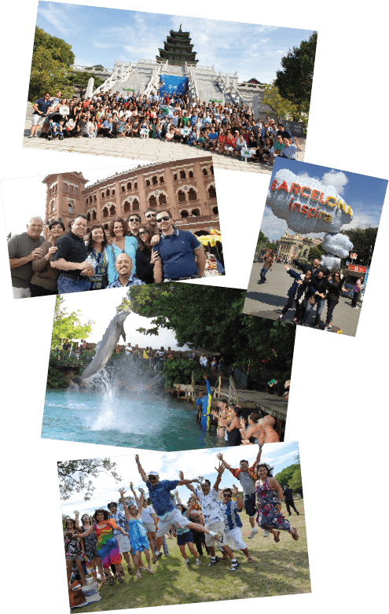
TRAVEL THE WORLD
Participate and qualify
for our dream trips around
the world every year.
We’ve brought thousands
of people to Paris,
Hawaii, Japan,
Thailand, Singapore,
Italy, Spain, Vietnam,
China, the Caribbean
and many more
exciting destinations.*
Happy Travels = Happy Families!
*These sales contests were sponsored by Independent Contractors of World Financial Group, Inc. (WFG) and or World Financial Group Canada, Inc.
All points are generated through the sale of products and services offered through WFG-affiliated companies.

Slide 14
LIFE IS ALL ABOUT CHOICES
What will your future look like 5 years from now?
1. Save your future
2. Build your future
Learn how money works.
Transition to an exciting career in the financial industry.
Make extra income on a flexible schedule.
Potentially build residual income and financial security with renewals, trails, supervision and override incomes.
Get rid of your debt.
Save for your children’s education and your retirement.
Build a team.
3. Be a part of something big
Build a large organization all over the US and Canada. Educate and help thousands of families.
“If you are born poor, it’s not your mistake. But if you die poor, it’s your mistake.” - MODERN WISDOM

Slide 15
MAKING A DIFFERENCE
Join our cause to fight debt, financial insecurity,
and financial illiteracy.
Our Mission:
Our Vision:
To build and protect wealth
for families.
We want to help people
move from financial insecurity
to financial independence.
To build a new industry with 1
million business associates worldwide
and revolutionize the financial
services industry to help resolve
the consumers’ dilemma–lack of
understanding, planning, and support.
“Find something you believe in,
and dedicate your life to fight for it.”
- XUAN NGUYEN

Slide 16
WFG consists of:
In the United States, World Financial Group Insurance Agency, Inc.,
World Financial Group Insurance Agency of Hawaii, Inc., World Financial
Group Insurance Agency of Massachusetts, Inc., World Financial Insurance
Agency, Inc. and/or WFG Insurance Agency of Puerto Rico, Inc. - collectively
WFGIA, which offer life insurance products.
Transamerica Financial Advisors, Inc. (TFA), Member FINRA, SIPC and
Registered Investment Advisor, which offers securities and Investment
Advisory Services offered through WFGIA and TFA are affiliated companies.
WFGIA Headquarters: 11315 Johns Creek Parkway, Johns Creek, GA 30097-
1517. Phone: 770.453.9300
TFA Headquarters: 570 Carillon Parkway, St. Petersburg, FL 33716.
Phone: 770.248.3271
In Canada, World Financial Group Insurance Agency of Canada Inc. (WFGC),
which offers life insurance and segregated funds.
WFG Securities Inc. (WFGS), which offers mutual funds.
WFGC and WFGS are affiliated companies.
Headquarters: 5000 Yonge Street, Suite 800, Toronto,
ON M2N 7E9. Phone: 416.225.2121
Not For Use In Puerto Rico or Quebec.
257908 TFA-05.20

