Slide 1
CAMPAIGN & COMPETE! EAST vs WEST
WHO WILL BE THE CAMPAIGNING CHAMPION?

Slide 2
FIRST
vs
FIRST
LAST
LAST
###
###

Slide 3
FIRST
vs
FIRST
LAST
LAST
###
###

Slide 4
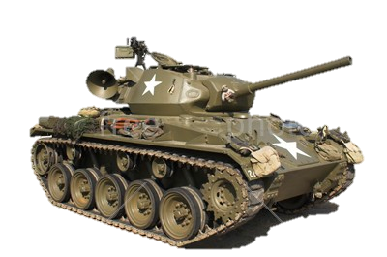
FIRST
FIRST
vs
LAST
LAST
###
###

